Slide 1

Team Krafterz
Miracle Dsouza
Rahul Dcosta
Sushmitha AA
Kiran Chitivolu

Slide 2

Flight Delay Trends
World without Delay trends and its problems
World with delay trends and benefits
Technical innovation
User experience
ROI

Slide 3

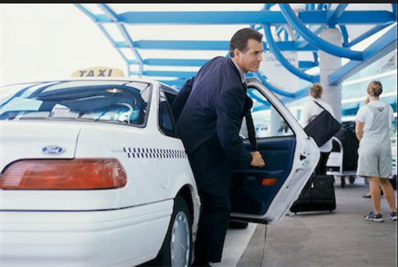



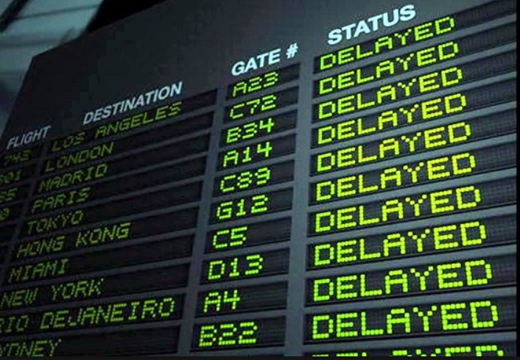
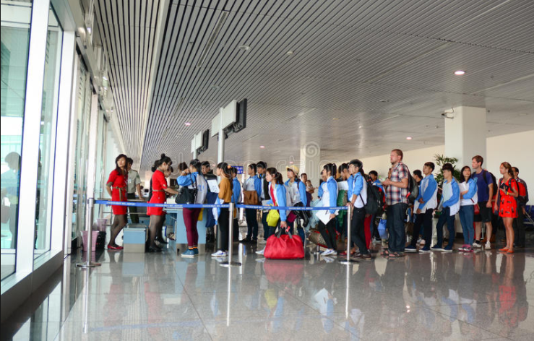
Why Delay Trends?

Slide 4





Frustration Cycle
Notes:
Din slp tiring , compensation fee issues

Slide 5





Delay Trend Engine
Delay Trend Predictions
Flight Stats Data
Delay Trend Engine
Notes:
Benefits:
Better User Experience
Since search after search is hard for users
Personalized interactions from recommendation engine makes our customer feel valued as an individual
Improved Customer Retention
The number which are shown are not just values but are indirect piece of advice
By introducing innovative ideas like this we are giving them a reason to stick with us.
Increase shop to book
By analyzing current site usage, a relevance engine can deliver relevant contents
The data is collected in real-time so the software can react as users shopping habits change
It will help increasing the shop to book ratio by additional relevant content and additional advices and directions

Slide 6








Working of Engine
Flight Stats Data
GetThere Portal
UI makes Availability Request and calls micro services
Training model in R using past data
Both Microservices call R server to get data
Past_Trend_Service
Response send in JSON by R server
Naïve Bayes Learning Model setup in R Server
Future_Prediction_Service

Slide 7
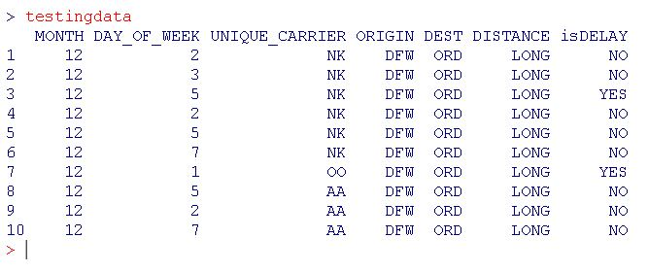
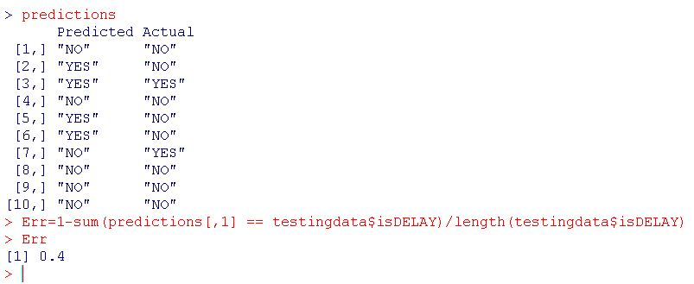
Verification of Predictions

Slide 8
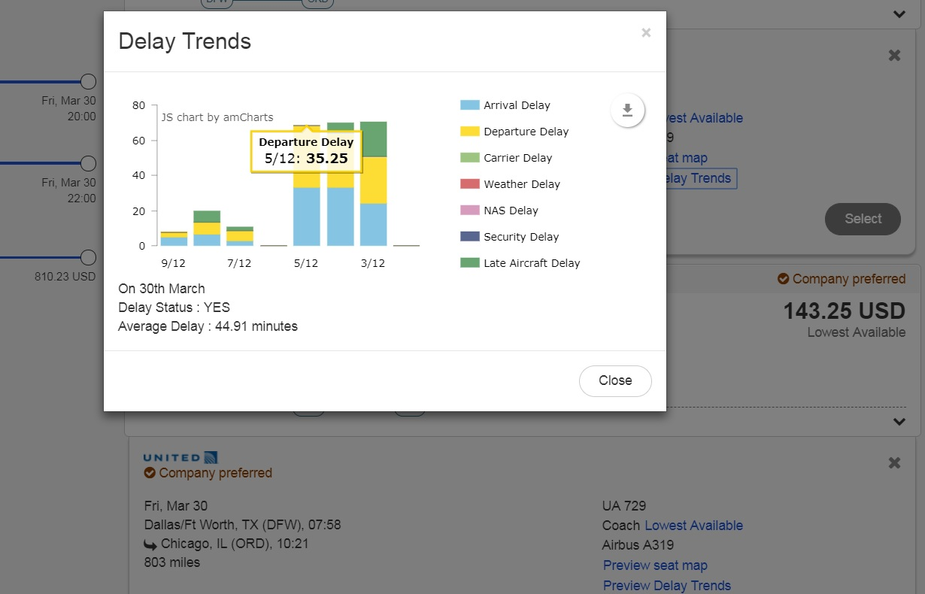

Delay on Avail Page
Notes:
Moreover, as we would like to give this information to the customer during the search and reservation process, the model will have to give long-term predictions, up to several months forward, and will not take into account short-term effects, like current weather or traffic situation.

Slide 9
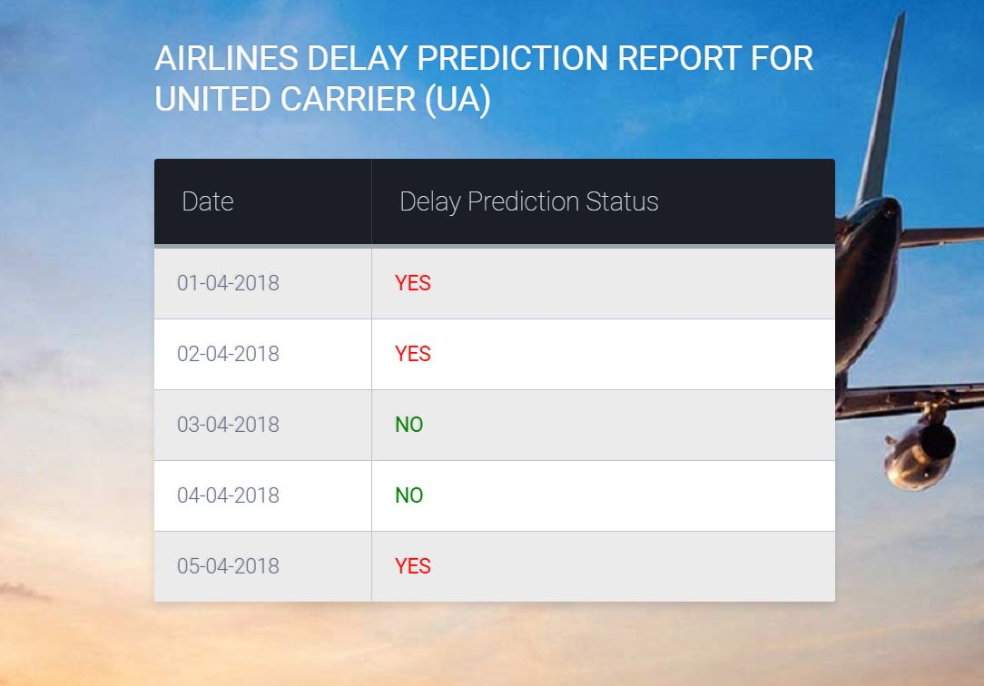
Delay Report for Airlines

Slide 10
DEMO

Slide 11
Benefits
Better User Experience
Improved Customer Retention
Better airline services and ranking
Reduces airline losses due to fine
Reduces traveler losses due to failed compensation
Avoids traveler frustration

Slide 12
ROI
Since this would be first of its type to be adapted among our competitors, we gain customer trust and confidence [Get There]
Hence assume we have even a minimum of 50 new bookings made per month
Assume a transaction fee of $10, We make a profit of 50x10=$ 500
From the point of view of marketing it as a standalone tool for airlines to fix human error [Airline Solutions]
Assuming we charge adoption fee $500 and setup a monthly contract @ $99/month .
If even 10 airlines adopt this we can make a profit of (500x10 )+ (99*12) =$6188
From the point of airports to track past & future trend [Airline Solutions]
Assuming we charge adoption fee $500 and setup a monthly contract @ $99/month .
If even 10 airport adopt this we can make a profit of (500x10 )+ (99*12) =$6188
Total profit : 500+ (6188x2)=$12876 (by touching only 10% of the market)

Slide 13
#Predicting_The_Future_By_Creating_It
Thank you

